Slide 1
STUDENT MANAGEMENT
SYSTEM
Project Evaluation Presentation
fhhfhhhhhhhhjnol
TEAM DETAILS
▸ Erukulla Mahanth Arya | Roll No: 2303A54028
▸
▸ A Sanjay | Roll No: 2303A54012 |
- Rounak raj|roll no : 2303a54043|
▸
Academic Year: 2024–25 | Dept. of Computer Science & Engineering

Slide 2
INTRODUCTION
Slide 02
📋 Project Overview
🎯 Problem Statement
A full-stack web application to manage student records, attendance, grades, and academic information efficiently.
Manual management of student data leads to errors, inefficiency, and difficulty in retrieval. A digital system solves these challenges.
💡 Solution Approach
🌐 Platform
A centralized dashboard with CRUD operations, real-time updates, and role-based access built using modern web technologies.
Accessible via web browser on any device. Hosted online with live URL for demonstration and use.
URL: https://student-mgmt-system-3.preview.emergentagent.com/dashboard

Slide 3
OBJECTIVES
Slide 03
01
Develop a centralized system to store, manage, and retrieve student academic records with ease.
02
Enable real-time tracking of student attendance, grades, and performance metrics.
03
Provide role-based access control for Admin, Teachers, and Students.
04
Build an intuitive, responsive dashboard accessible from any web browser.
05
Demonstrate effective use of AI tools (prompts) to generate functional full-stack code.
06
Ensure data security, scalability, and seamless user experience across the platform.

Slide 4
STAKEHOLDERS
Slide 04
For Whom the Project is Done
👨‍💼
System Admin
👩‍🏫
Teachers / Faculty
🎓
Students
Manages the entire system. Adds/removes users, configures settings, monitors system health and access logs.
Enters grades, marks attendance, views student performance and generates academic reports.
Views own academic profile, attendance record, grades, timetable, and receives notifications.
👨‍👩‍👦
Parents / Guardians
🏫
Institution / Management
Monitors ward's academic progress, attendance, and receives alerts for poor performance.
Views aggregated analytics, monitors department-level performance, and ensures compliance.

Slide 5
PROGRAMMING LANGUAGES, TOOLS & SOFTWARE
Slide 05
Frontend
Backend
Database
AI & Dev Tools
Deployment
▸ React.js
▸ Node.js
▸ MongoDB
▸ Claude AI (Anthropic)
▸ Emergent Agent
▸ HTML5 / CSS3
▸ Express.js
▸ Mongoose ODM
▸ ChatGPT
▸ GitHub
▸ JavaScript (ES6+)
▸ REST API
▸ Cloud Atlas
▸ VS Code
▸ Vercel / Render
▸ Tailwind CSS
▸ JWT Authentication
▸ JSON Storage
▸ GitHub Copilot
▸ npm / Node
Primary AI Tool: Claude (Anthropic) — used to generate majority of the application code via prompts

Slide 6
PROMPTS USED TO GENERATE CODE
Slide 06
P1
Build a full-stack Student Management System with React frontend and Node.js backend. Include student CRUD operations, login authentication, and a dashboard with stats.
P2
Create a student attendance tracking module with a calendar view, where teachers can mark present/absent and the system auto-calculates attendance percentage.
P3
Add a grades management feature where teachers can enter subject-wise marks, the system computes GPA, and students can view their grade report card.
P4
Design a responsive admin panel with sidebar navigation, using Tailwind CSS. Include charts showing student performance analytics using recharts library.
Additional prompts shown in subsequent slides and submitted as separate document

Slide 7
WORKFLOW FLOWCHART
Slide 07
User Opens App
Login Page
Valid Credentials?
Error Message
NO →
YES
Dashboard
Role-Based Access
Admin
Teacher
Student
Manage Data
Logout

Slide 8
FRONT-END VIEW OF THE APPLICATION
Slide 08
https://student-mgmt-system-3.preview.emergentagent.com/dashboard
🏠 Dashboard
📊 Student Management Dashboard
👥 Students
1,248
1,102
3.42
24
Total Students
Present Today
Avg. GPA
Courses
📋 Attendance
ID | Name | Dept | GPA | Status
S001 | Rahul Sharma | CSE | 3.8 | Active
S002 | Priya Reddy | ECE | 3.5 | Active
S003 | Kiran Patel | MECH | 3.2 | Active
📊 Grades
📅 Timetable
⚙️ Settings
Screenshot placeholder — insert actual application screenshot here

Slide 9
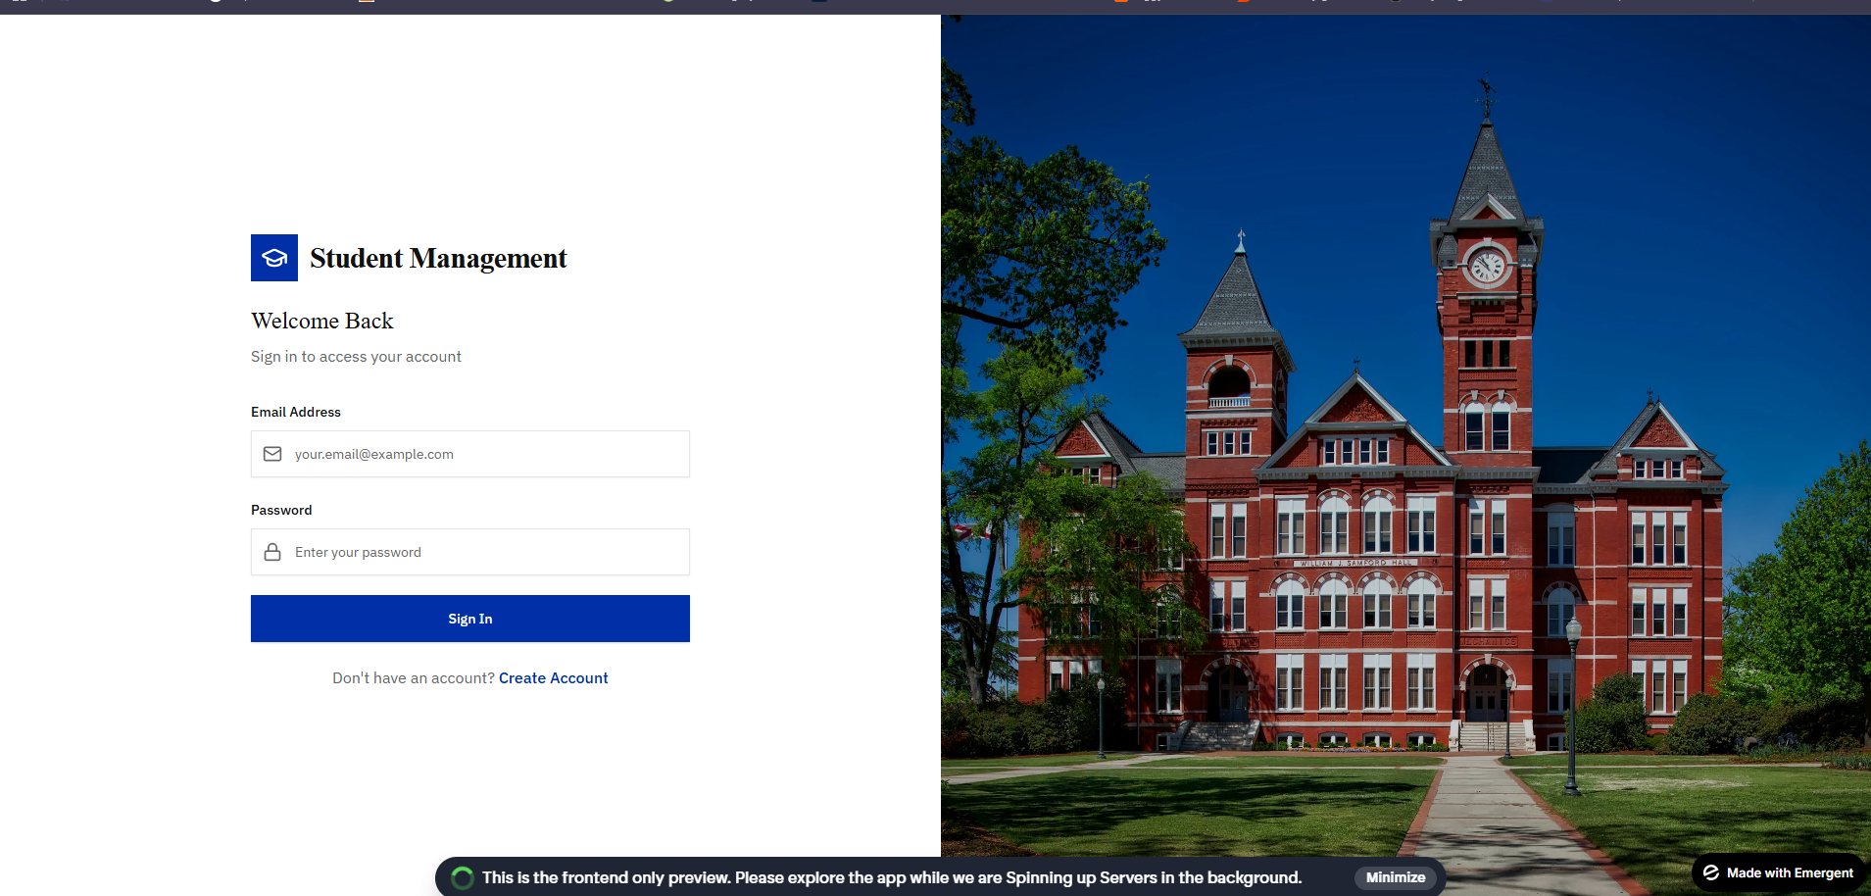
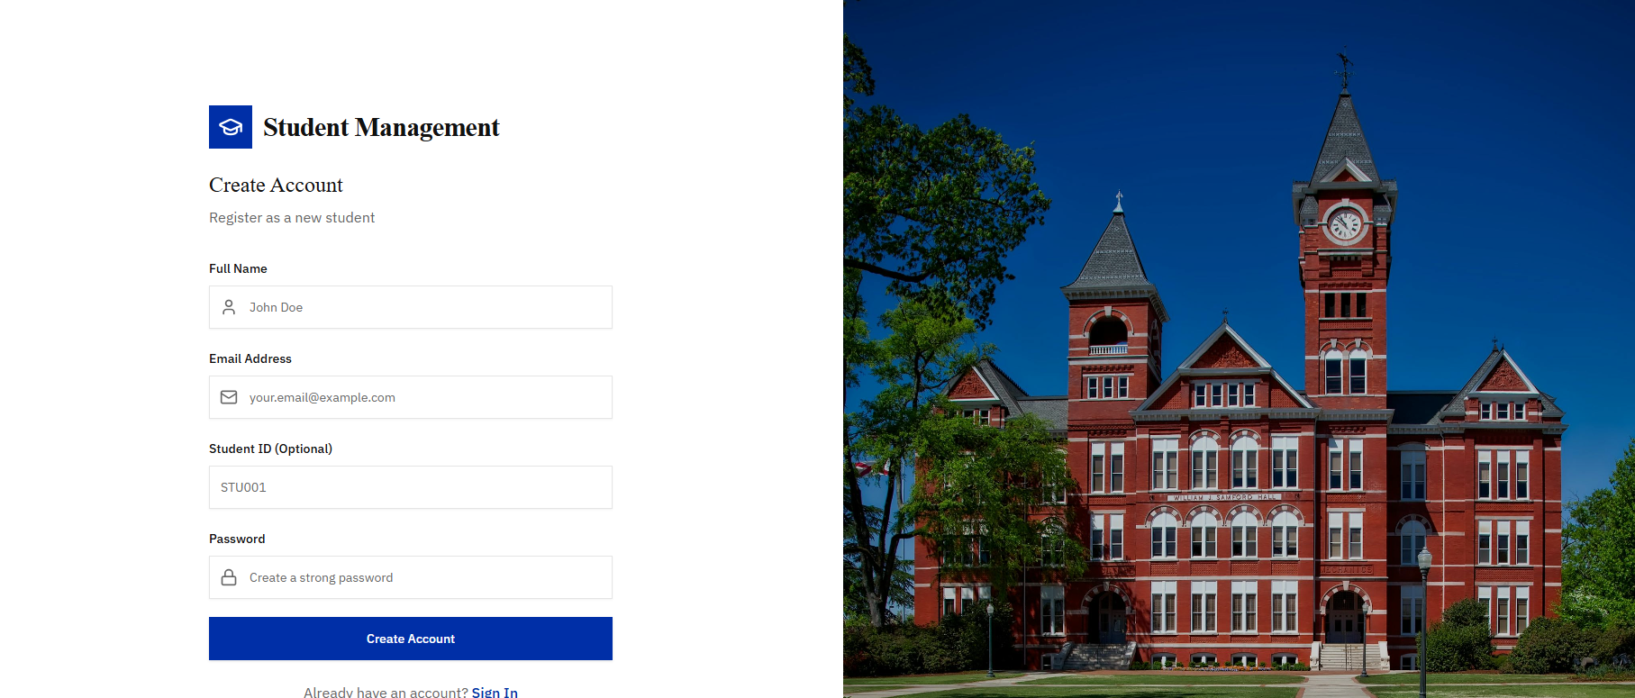
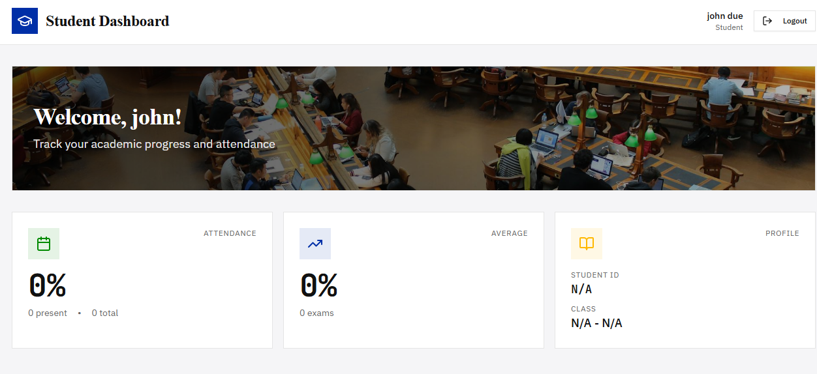
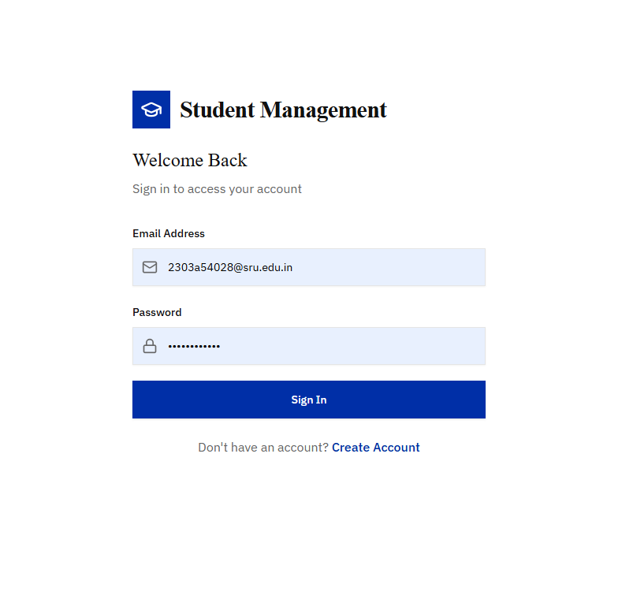
PROOF OF PROMPTS GENERATING CODE
Slide 09
Screenshots of AI generating code from prompts
📸
📸
Insert Screenshot Here
Insert Screenshot Here
Screenshot 1: Claude generating React Dashboard code
Screenshot 2: AI generating student CRUD API
📸
📸
Insert Screenshot Here
Insert Screenshot Here
Screenshot 3: Prompt for attendance module
Screenshot 4: AI generating database schema
Replace placeholder boxes with actual screenshots of AI tool interface showing code generation

Slide 10
REFERENCES
Slide 10
AI Tools
Technologies
▸ Claude (Anthropic) — claude.ai — AI assistant used for code generation
▸ React.js Documentation — reactjs.org
▸ ChatGPT (OpenAI) — openai.com — Supplementary AI for logic generation
▸ Node.js & Express.js Docs — nodejs.org / expressjs.com
▸ MongoDB Documentation — mongodb.com/docs
▸ Tailwind CSS — tailwindcss.com
Deployment
Learning Resources
▸ Emergent Agent Platform — app.emergent.sh
▸ MDN Web Docs — developer.mozilla.org
▸ GitHub — github.com — Version control & code hosting
▸ W3Schools — w3schools.com
▸ freeCodeCamp — freecodecamp.org
Thank You | Student Management System | Computer Science & Engineering

